Slide 1
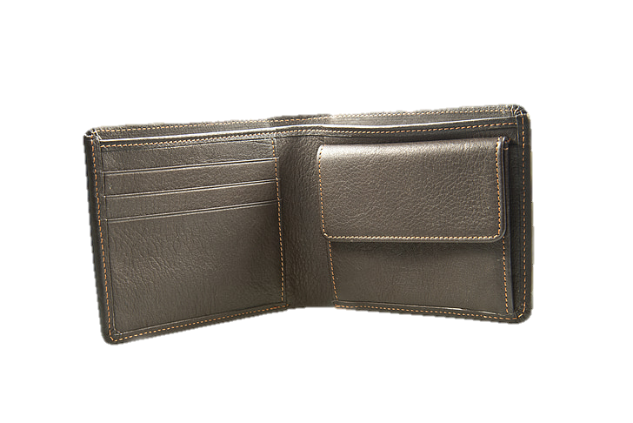

tohle nemuzem prezentovat kamo

Slide 2
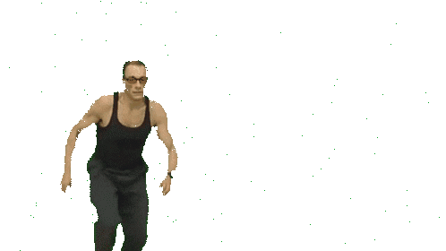

Slide 3


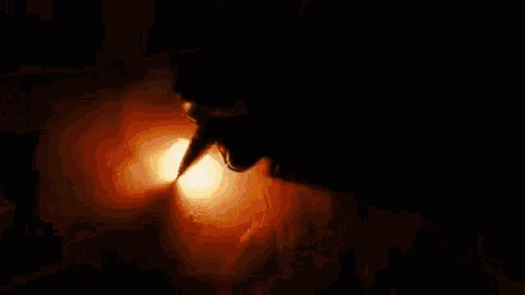



Wallet theft is a common issue worldwide, leaving victims feeling helpless and losing valuable items.
“What if the thief couldn’t get away so easily?”
The Solution: A wallet that fights back, making theft more inconvenient than ever.
Notes:
Wallet theft is a common issue worldwide, leaving victims feeling helpless and losing valuable items.
The Solution: A wallet that fights back, making theft more inconvenient than ever.

Slide 4



A theft-deterrent wallet that explodes when stolen to surprise and deter thieves.
Contains a GPS tracker to help locate the wallet if lost or stolen.
Compact and slim to fit easily in pockets or small bags.
Notes:
we allow family sharing, so if you get lost (or stuck under the roots of tree) you can be located

Slide 5
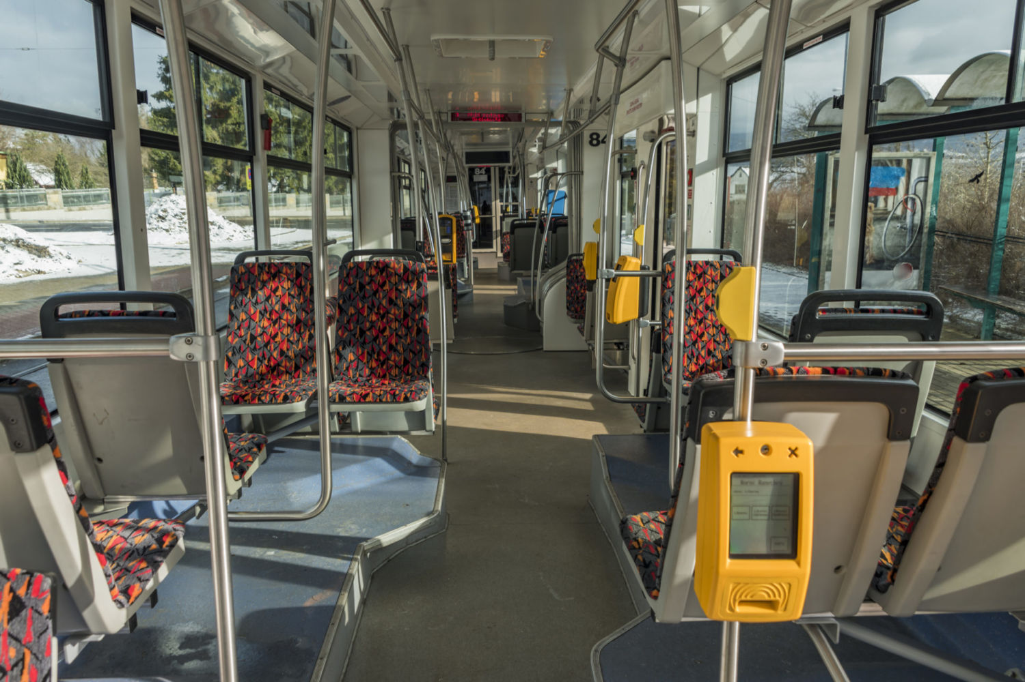
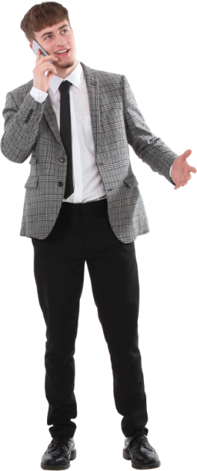
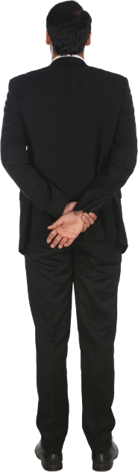
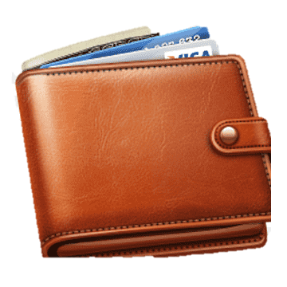
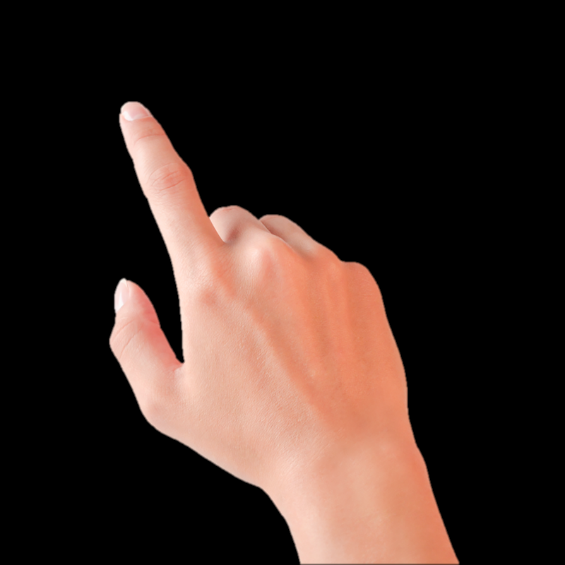

Slide 6


Slide 8
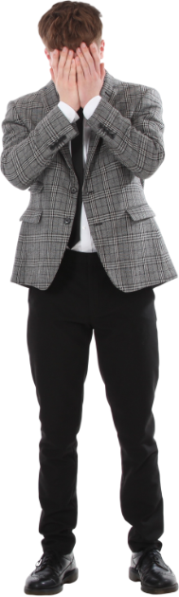

Slide 9
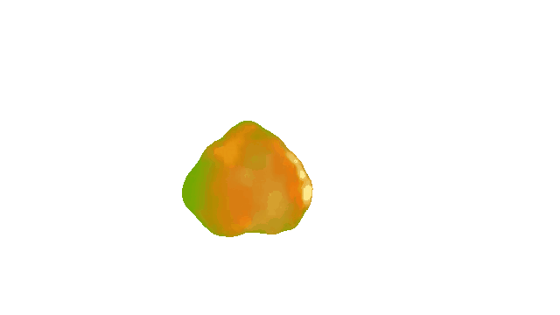


Slide 10
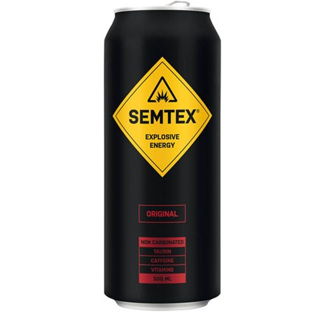
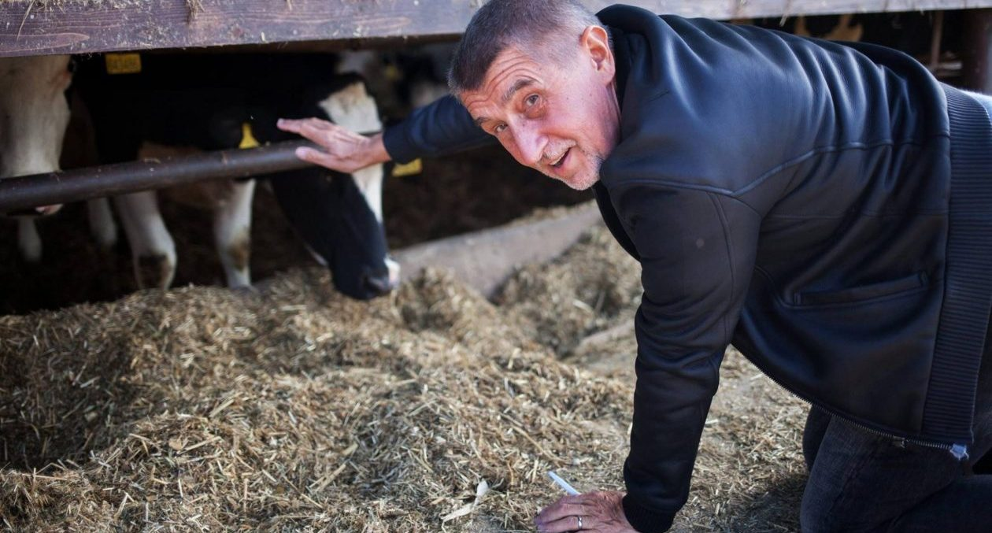


We proudly use premium explosive made in the Czech Republic to ensure quality and support local craftsmanship.
To ensure premium durability we use high-quality leather from local Czech farmers.
Our wallets are proudly handcrafted by skilled Czech artisans, ensuring exceptional quality while supporting local craftsmanship and communities

Slide 11
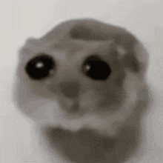

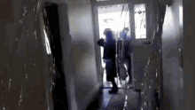

Wallet theft will significantly decrease
You may be wanted by the police for possesion of explosives. (if you get caught)

Slide 12
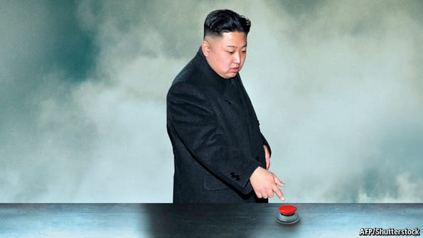
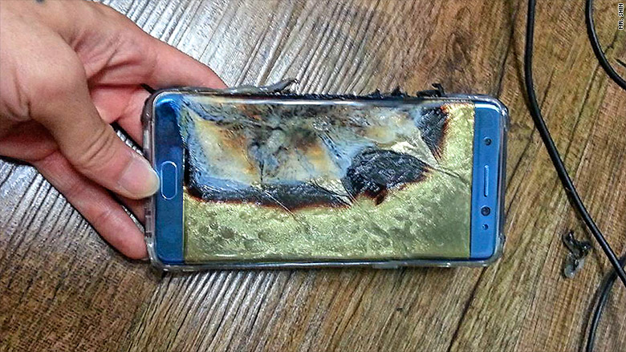


Explosion is triggered remotely or automatically after a specific distance from the owner. (Can be dissambled)
Smart integration with a mobile app to activate/deactivate the self-defense mode.
Battery life: up to 3 months per charge.
Notes:
Other features are:
remote/automatic detonation,
integration with mobile app (settings),
3 months battery life
If you have a problem with your phone being stolen, look no further than our competitor Samsung and their Note 7 lineup

Slide 13


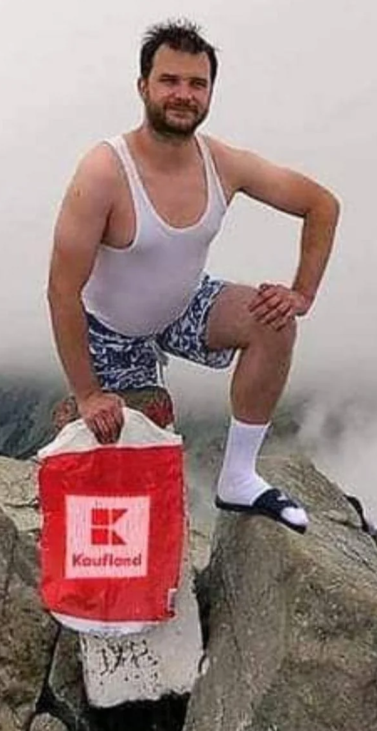


Professionals who carry important cards, cash, and IDs
Travelers concerned about pickpockets
Tech enthusiasts who love innovative gadgets
Notes:
Lets talk market

Slide 14



experimental innovations
Thief detection based on aura
The carefully designed and expertly calibrated device is capable of identifying even the most subtle aura variations All data collection processes strictly comply with European and US legal standards !

Slide 15



Slide 16
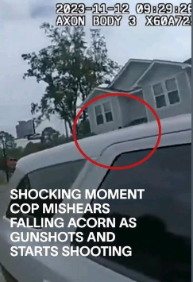
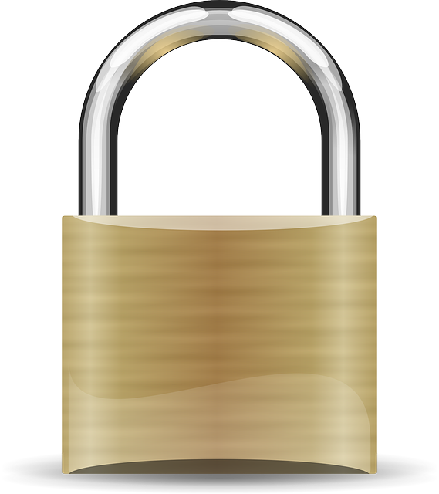

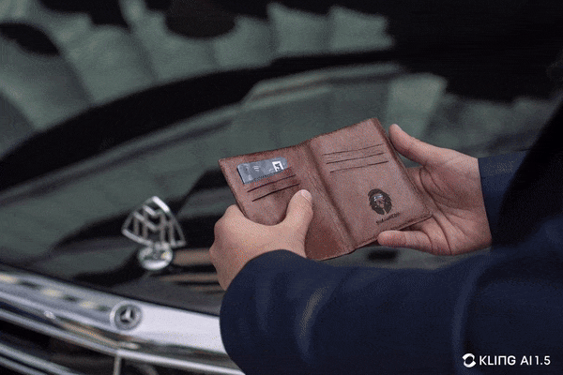
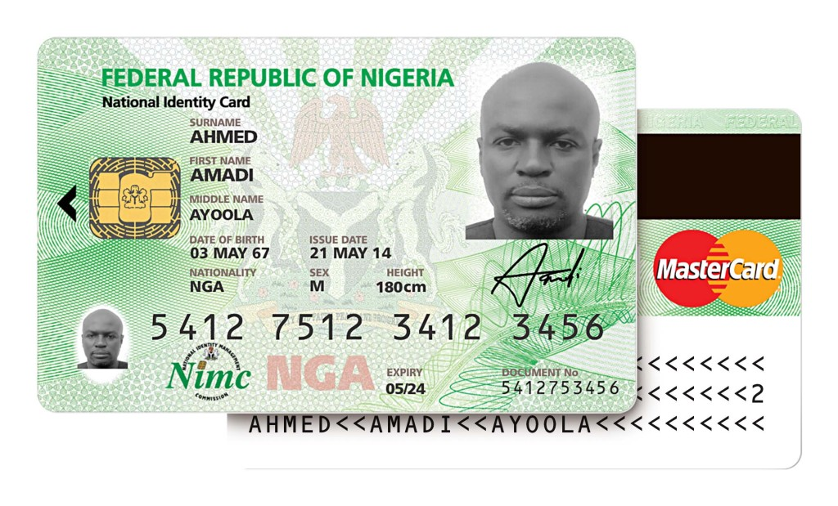
Identity secure
Your safety and satisfaction are our utmost priorities.
To comply with legal standards, every product includes a fail-proof safety chamber designed to ensure that all your personally identifiable data is securely voided at the precise moment of the wallet's final existence.

Slide 17
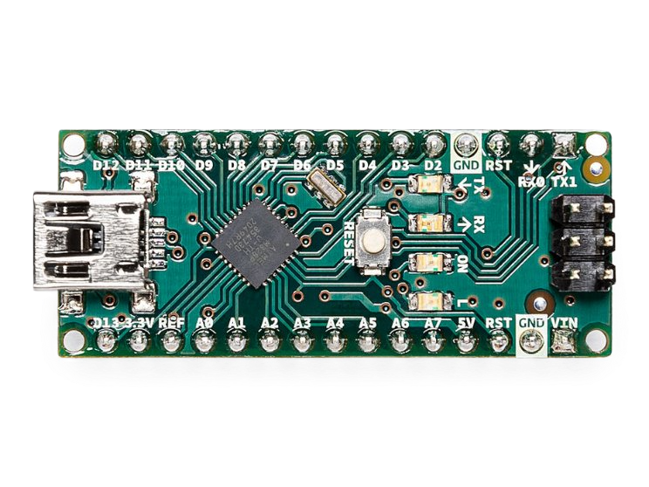
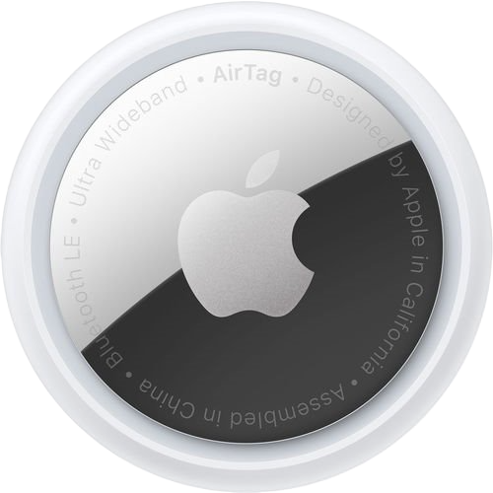


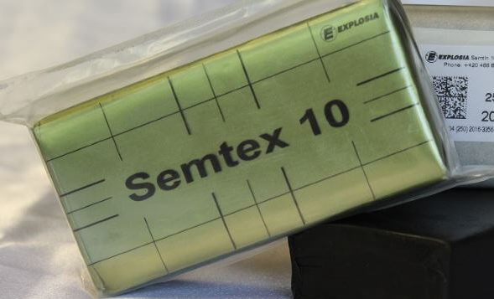
670,83 Kč
lil bro, sem napiš jak získáme peníze @Lukáš
1 413 040 ﷼
0,000011 ₿
32,- €
Notes:
Czech korunas, Bitcoins, euros and Iranian rials
Arduino Nano, some random leather wallet, SEMTEX® 10, Apple Airtag

Slide 18
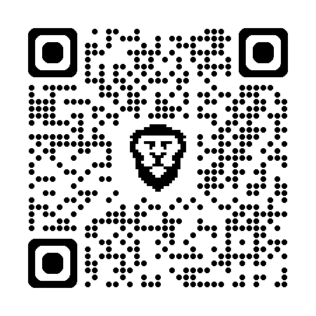


Our website (explosives are against TOS of normal platforms)
Goal: not to get arrested, 29 947 600 ¥
Benefit: 3 wallets (without subscription) (meaning, you can get robbed twice and we still send you new unit)
Notes:
~30 milion japanese yens
(200 000 USD)

Slide 19
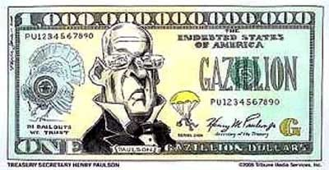
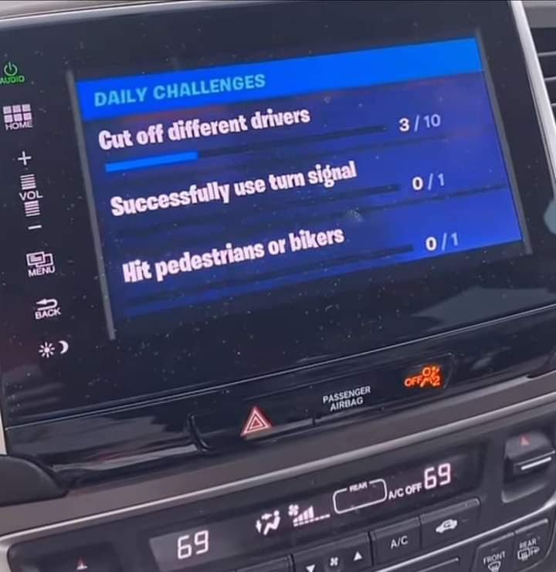
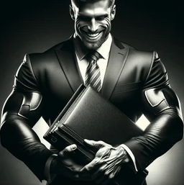
Pricing
nekdo to upravte dejte sem ceny treba @vaclav_kozeny
Education
Family
Charity
free
4.89 $
11.73 $
4.89 $
11.73 $
Personal
Professional
Enterprise
24.59 $
291 $
Battle pass coming soon
Notes:
Monthly subscription
we send you new wallet

Slide 20
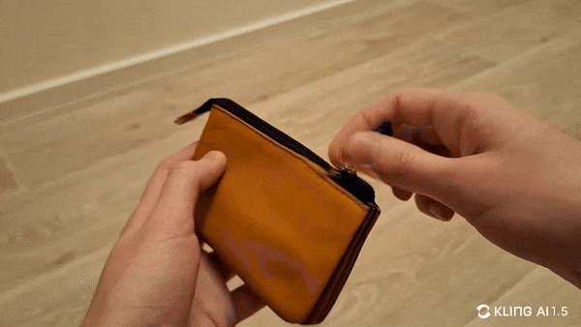
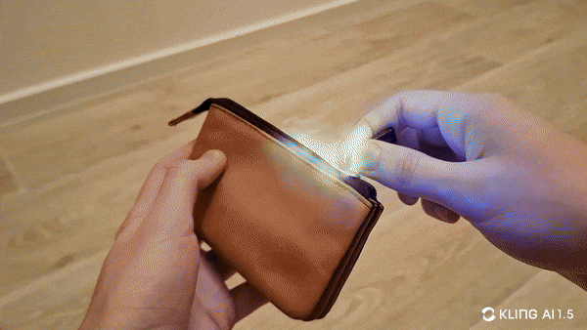


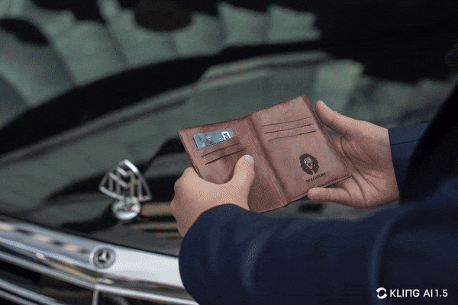
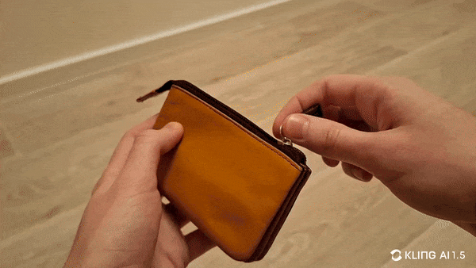

Vast Selection of Products
Notes:
Future plans

Slide 21

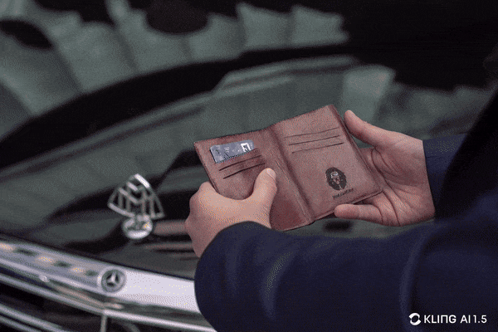

Exclusive Limited New Year Edition

Slide 22
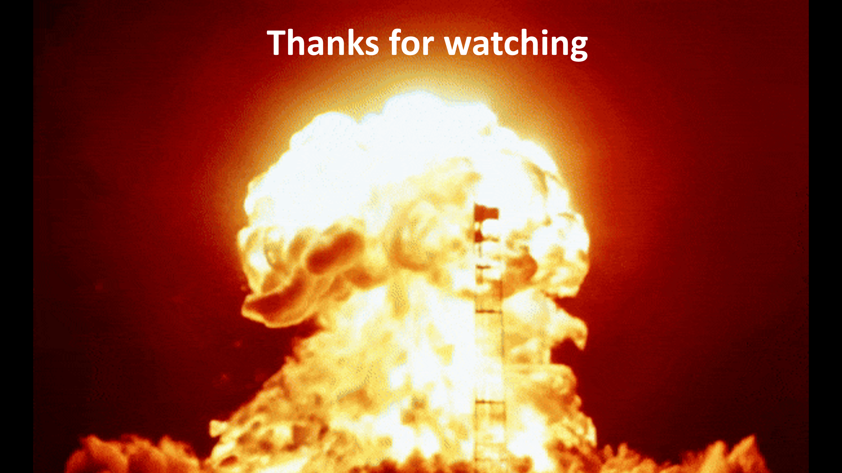
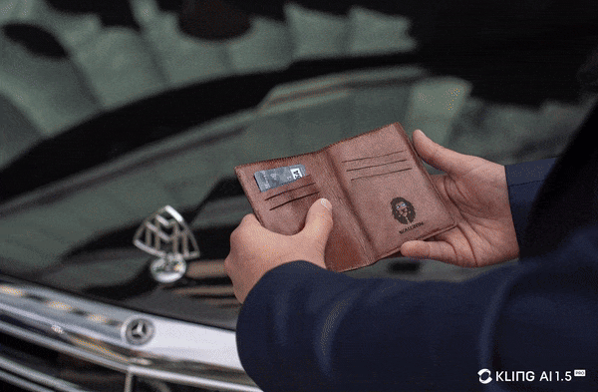
Thanks for watching

Slide 23
